Slide 1
happy

Slide 2
sad

Slide 3
OK

Slide 4
angry

Slide 5
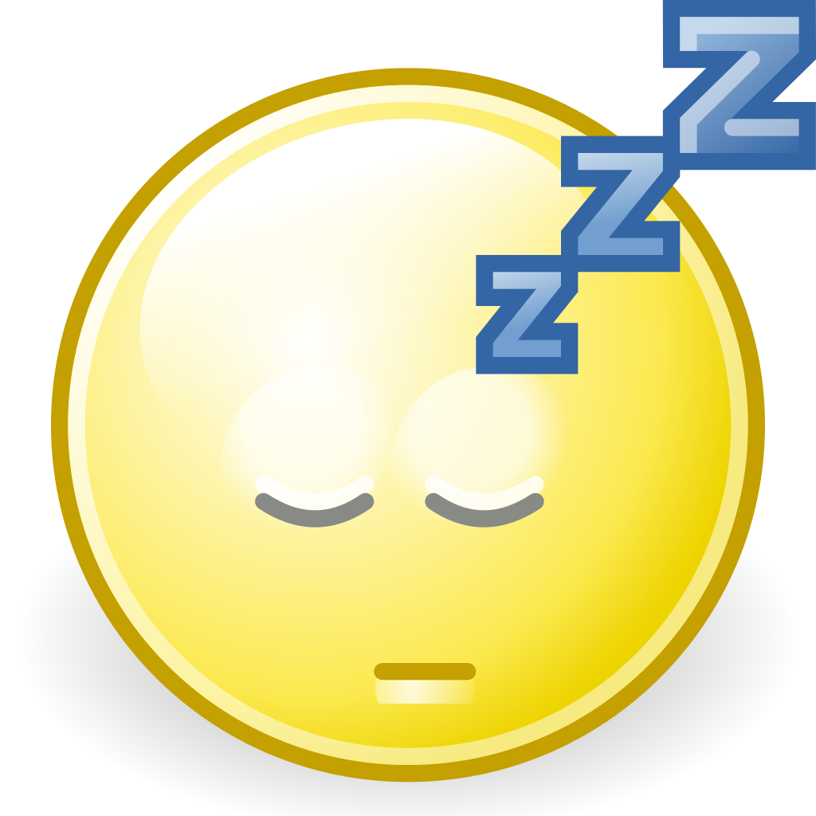
sleepy

Slide 6
great

Slide 7
hungry

Slide 8
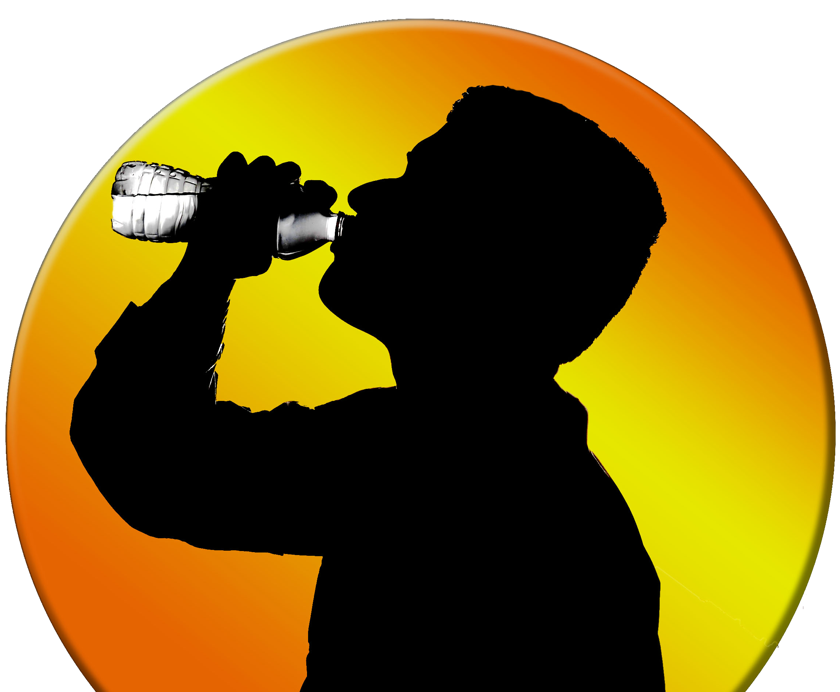
thirsty

Slide 9
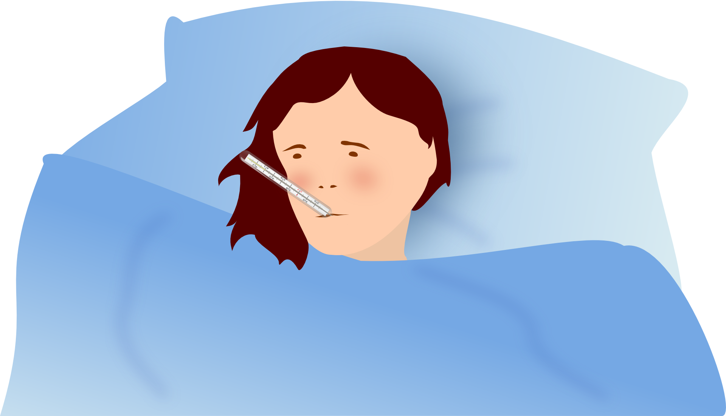
sick

Slide 10
bored

Slide 11
tired

Slide 12
scared

Slide 13
surprised

Slide 14
worried

